Slide 1

Підсумковий урок. Цікаві історії. Казка "Мурашиний гриб"

Slide 2
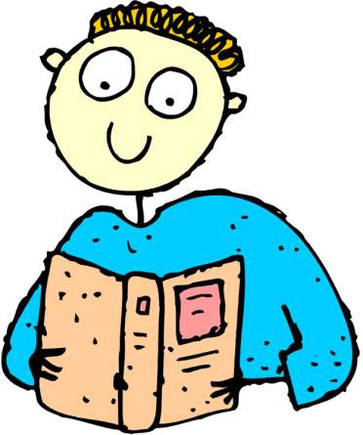
Hello! My name is Jason!
I am glad to see you. Today we have an interesting competition “Merry and Curious”!
I think, you don`t know English language. Let’s check it!
There are 12 tasks for you.
I wish you success!

Slide 3

I think, you have forgotten an English alphabet.
My first task is
finding of missing letter

Slide 4

B, D, K, Y.

Slide 5
My second task is
writing words in the alphabetical order:

Slide 6

Let`s check:
1) apple 9) ice 17) queen
2) bed 10) jam 18) right
3) chocolate 11) kiss 19) send
4) dear 12) last 20) table
5) end 13) mother 21) union
6) flower 14) name 22) vase
7) garden 15) orange 23) work
8) holiday 16) present 24)xylophone
25) you 26) zoo

Slide 7
Now, children,
say antonyms:
sister old yes black short father hello small up white bad goodbye girl good happy new long brother big mother sad no down boy

Slide 8


black – white long – short
yes – no father - mother
up – down new – old
hello – goodbye happy – sad
small – big girl – boy
good – bad sister – brother

Slide 9
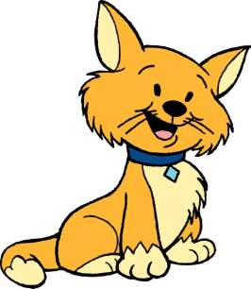
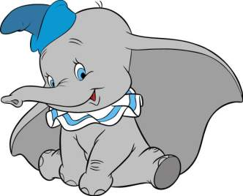
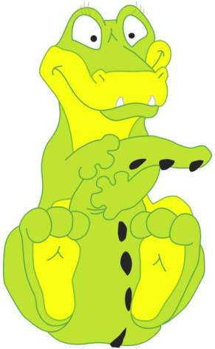
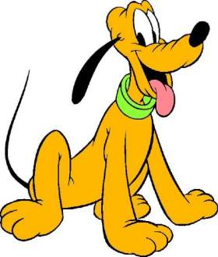
GUESS the RIDDLES

Slide 10
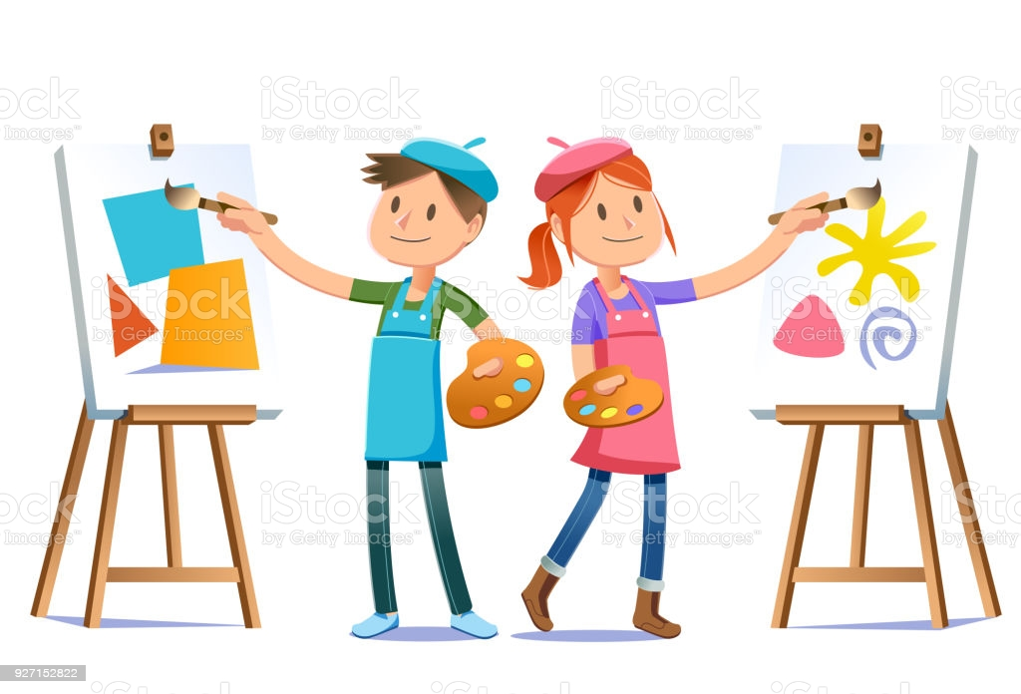
Our Young Artists

Slide 11

We can`t manage without verbs.
My next task is finding verbs:

Slide 12

RUN WASH SING
SIT GO WRITE
EAT DO READ
PLAY

Slide 13

Now make sentences:

Slide 14


I usually watch TV on Sunday.
She always plays the piano at home.
He often cleans his teeth in the morning.
He doesn`t read fairy-tales to my sister.
It`s time to go to bed.
He likes jam, cakes, sweets.

Slide 15

Dear children, now I see that you know English very well. You are good pupils.
Thank you for your hard work.
See you again.
Good Bye.

Slide 16
Good for you!

